Slide 1
Week 6: Final Project Details
Thursday, February 10, 2022
TA: Graham

Slide 2
Final Project
A visual project where you will be curating a photography exhibition on a subject/theme of your own choosing.
This will consist of:
A curatorial statement that is 250 words
10 photographs with a 2-3 sentence caption. These images must be placed within a historic, thematic and/or theoretical framework.
The project is due Week 9 (March 7-11) where you will be handing in a hard copy to me during this section. Late projects and rewrites will only be accepted by prior arrangement.

Slide 3
Curatorial Statement
Needs to be double spaced, Times New Roman and 12-point font.
What is a curatorial statement?
A “guide” to an exhibition. It allows for viewers to see where you are coming from, give them a framework of what to be thinking about, and to consider certain ideas/questions as they move through it.
“You must use the course material and two additional sources to contextualize your subject in your curatorial statement. Sources published online must be peer reviewed and published in an academic journal (see resources folder for more information). No sources with unknown authors will be accepted.” (from Syllabus) Make sure to cite!
There is no one way to write one, but an example maybe: “using the first paragraph to establish the overall premise of the exhibit, the second to illustrate the range of artists’ approaches with examples, and the third to suggest the wider significance of your theme.” (RISD Writing Center, “Curatorial Statement Guidelines)

Slide 4
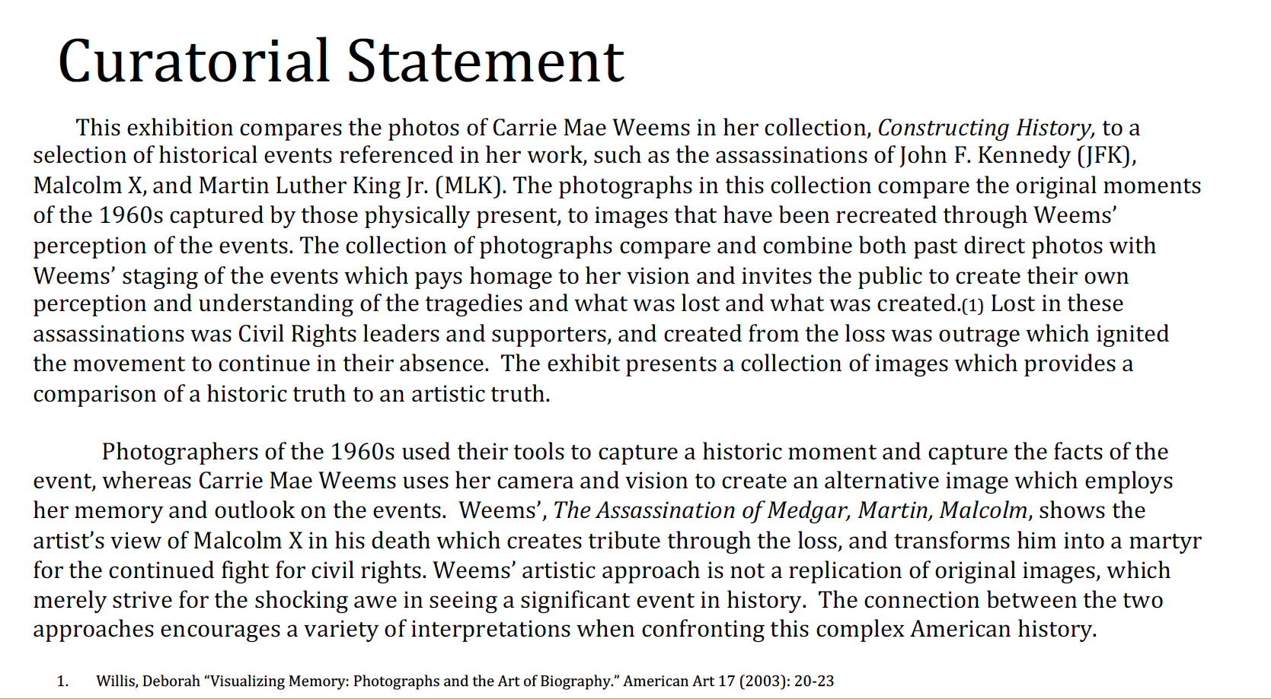

Slide 5
ICONS OF STYLE: A CENTURY OF FASHION PHOTOGRAPHY, 1911-2011
Getty Museum (https://www.getty.edu/art/exhibitions/fashion_photography/)
Why do some fashion photographs transcend their commercial character to function as
works of art, while others do not? In part, the answer lies in the ability of a fashion
photograph to reflect two or more worlds: the perfect world inside the frame—where
youth, beauty, and luxury reign supreme—and the harsh realities of the world outside
it. The best fashion photographs remind us of other works of art or expand the
boundaries of the genre, redefining what a fashion photograph is supposed to do, or be.
Beginning with 1911—the year Edward Steichen created the first “artistic” fashion
photographs—and ending with 2011 with digital technology as a dominant paradigm,
this exhibition surveys the rich and varied history of modern fashion photography. The
show traces its trajectory from niche industry to powerful cultural force, and its gradual
embrace as an art form.

Slide 6
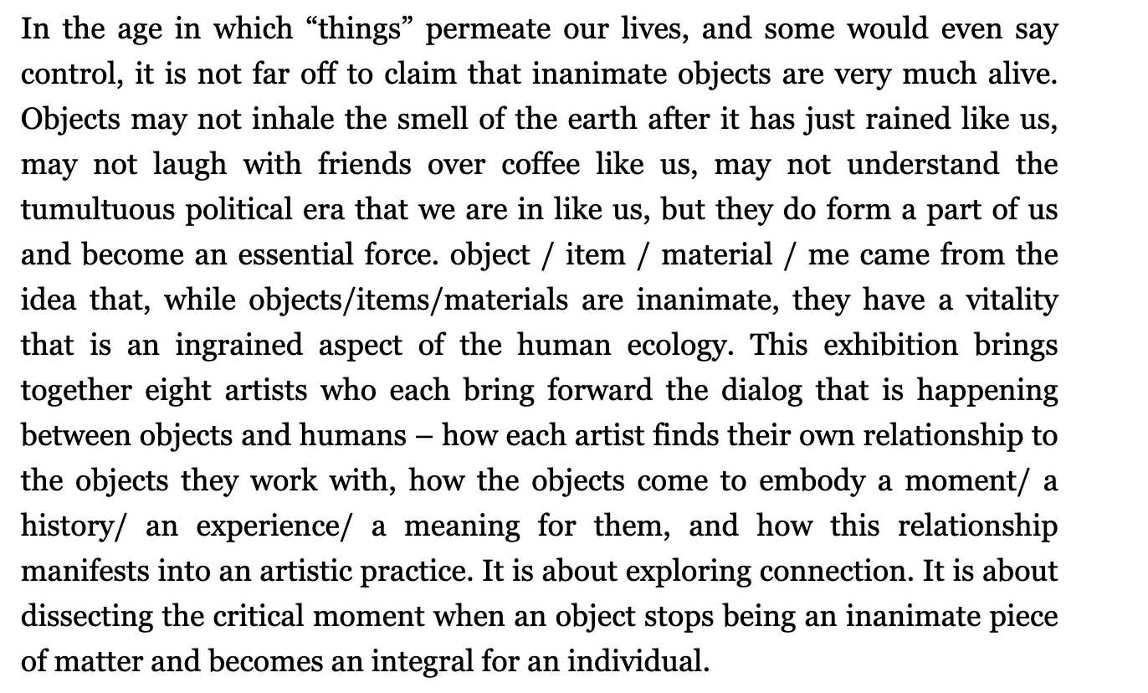

Slide 7
Captions
You will caption and contextualize the selected images (2 to 3 sentences per image).
Images must be placed within a historic, thematic, and/or theoretical framework (similar to the Image ID section in exams).
For more information on writing label see the Museum of Modern Art PowerPoint presentation “Writing Effective Art Labels: A Nuts and Bolts Primer.”
(link here https://www.slideshare.net/stephaniepau/writing-effective-interpretive-labels-for-art-exhibitions-a-nuts-and-bolts-primer)

Slide 8
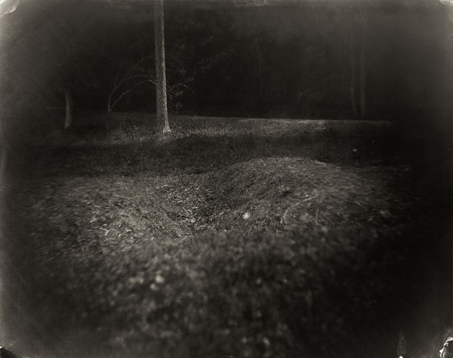
Similar to Image ID section of the exams
Visual details of the image. What do you see in the slide? Pay particular attention to the visual space and layout.
Location
Contextualize the image
Sally Mann: A Thousand Crossings
GETTY CENTER
Daily, through February 10, 2019
Sally Mann, Battlefields, Antietam (Trenches), gelatin silver print 2001.
Wall Label (caption example)
The Battle of Antietam, fought near Sharpsburg,
Maryland, on September 17, 1862, was the bloodiest
single day of the American Civil War, with more than
twenty-three thousand Confederate and Union casualties.
One Union surgeon reported that most of the dead
remained unburied more than a week later.
By positioning her camera close to the ground for a
number of these photographs, Mann assumed the
viewpoint of a dying soldier. She used antique lenses,
welcoming the light leaks, fogging, and flares they produced to convey the unsettling history of the landscapes.

